Slide 1

RACE
GAME
3D
RACING
Made by Cassie Alice Angela Sylvia

Slide 2
CON
A：Game Introduction & Problems
B：Figma；Design Framework
C：Technical Details
- Driving Backward
-Operation Keys
-Acceleration Belt
C：Future Expectations

Slide 3
A

Slide 4

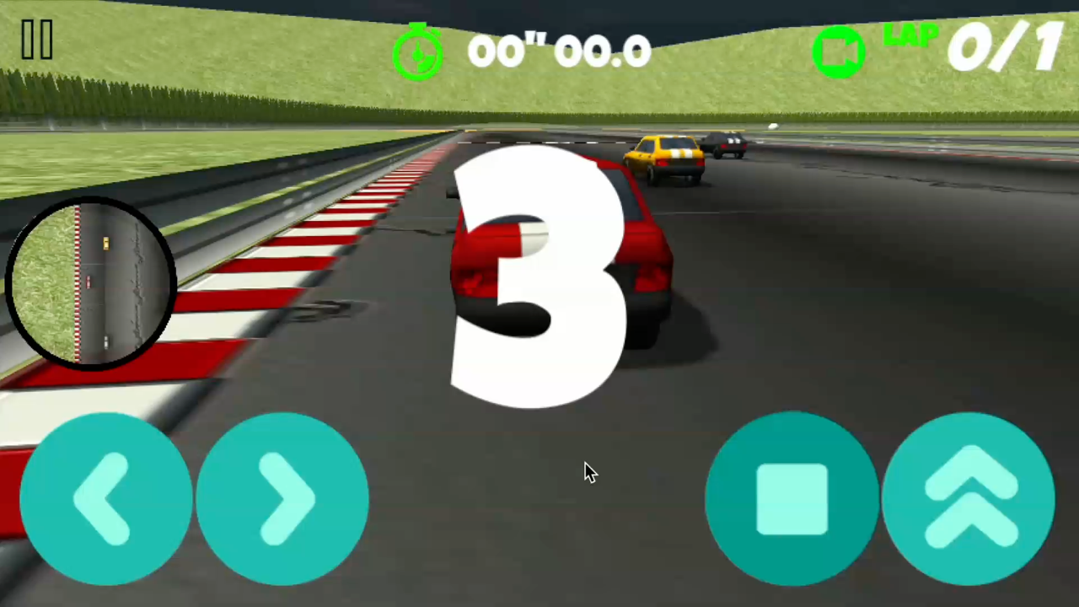
Start（Before）
No Changing Game
No Changing Game

Slide 5


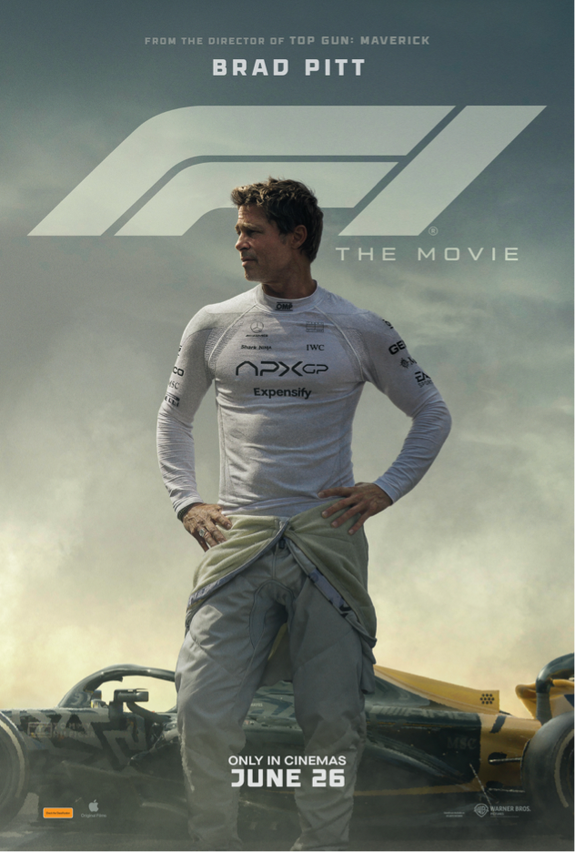
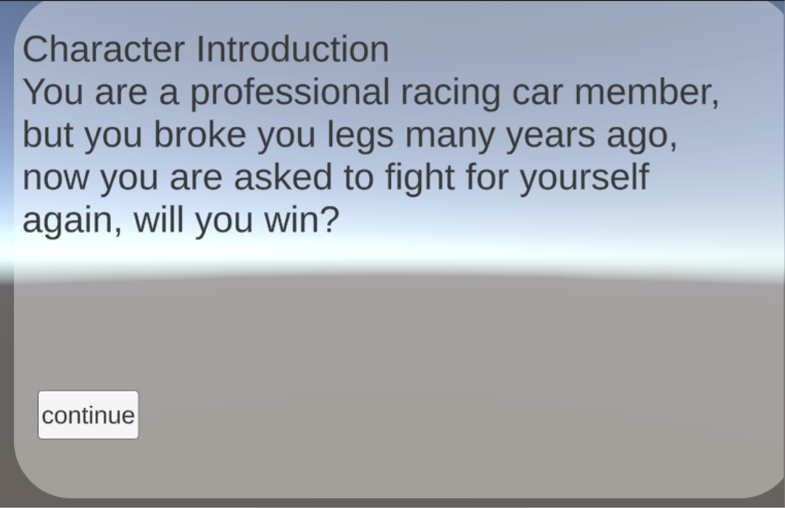
Start
Car Race
Conception Problems 1
Background : motivation(HCI) connect emotion with character

Slide 6
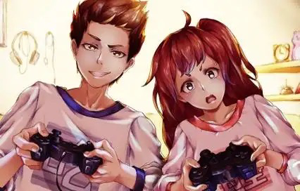
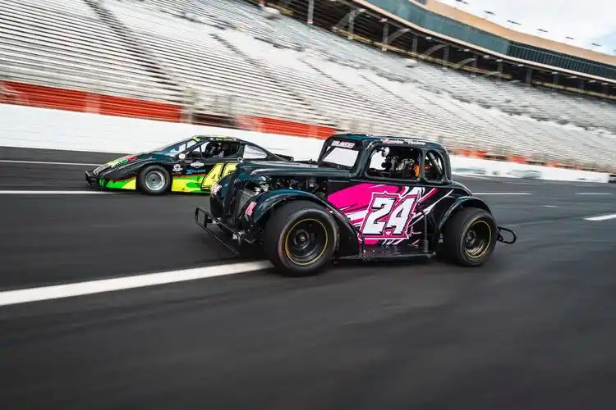
Start
Car Race
Conception Problems 2
Why are racing games (traditional male oriented themes) more difficult to attract girls?
Reason：
-Social Stereotype
-Content of game design
-Game Community
Solution➡️

Slide 7
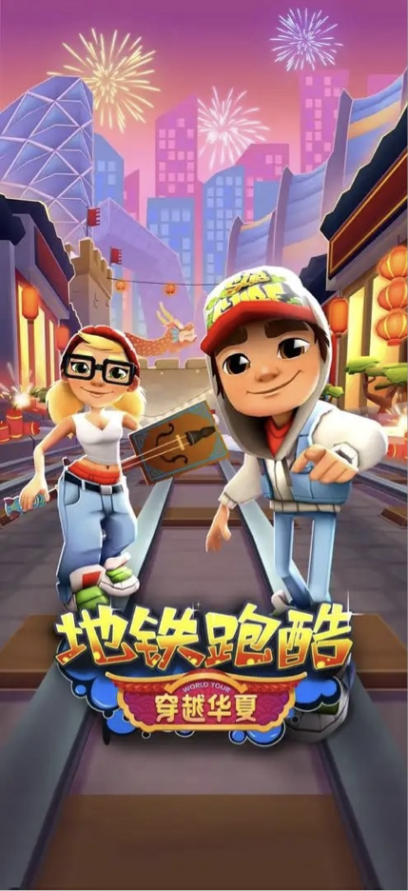
Subway Surf
Tips：though not car-racing games, can still work as a successful case for analyzation
-Simple operation + instant feedback
-Art style: vivid colors, diverse characters, etc
-Play with little stress
-Continuous updates and global cultural elements

Slide 8
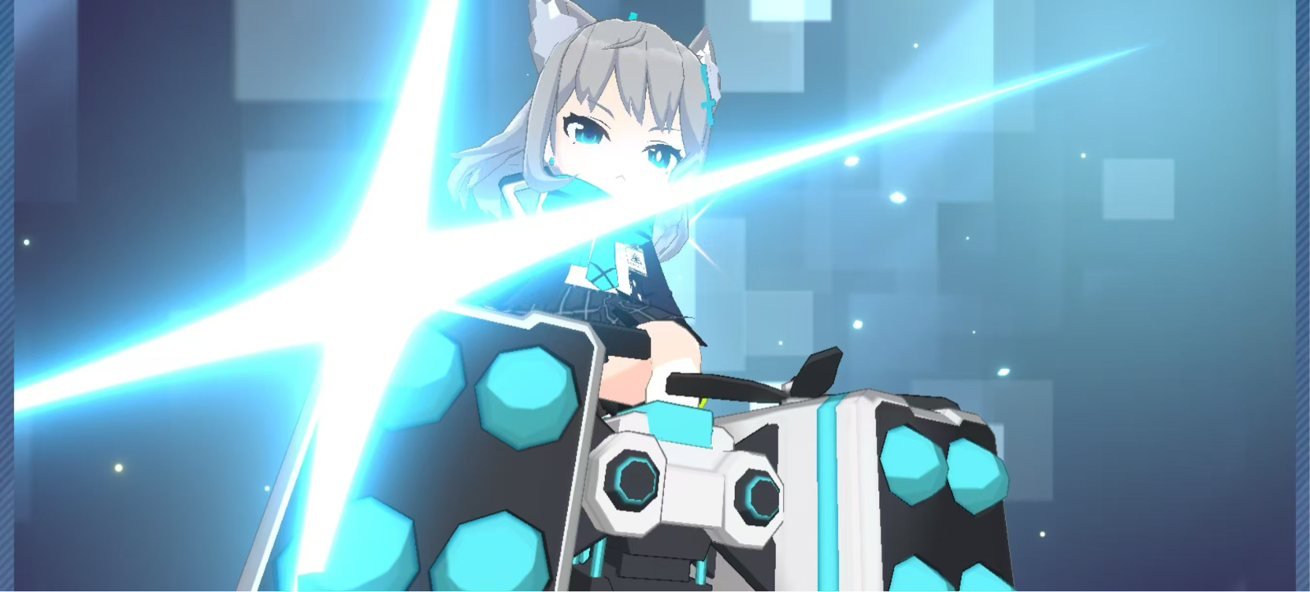
Solution
We are not working on 'how to make girls like boys' hobbies', but on' how to make games meet the needs of different players'.
-Game stories and themes
-Reduce difficulty of control, increase positive feedback instead
-Art and Sound Design
-Business aspect: linkage with brands/other games/etc

Slide 9
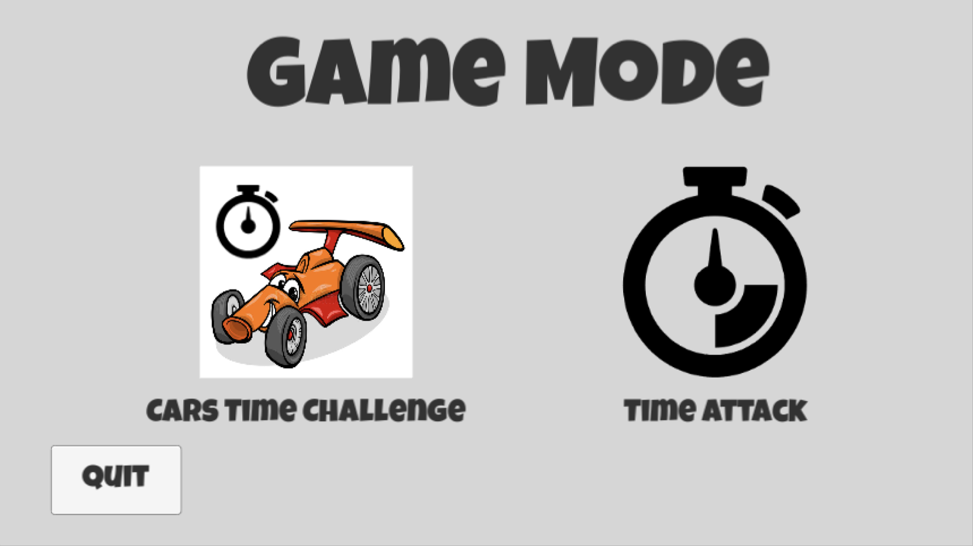
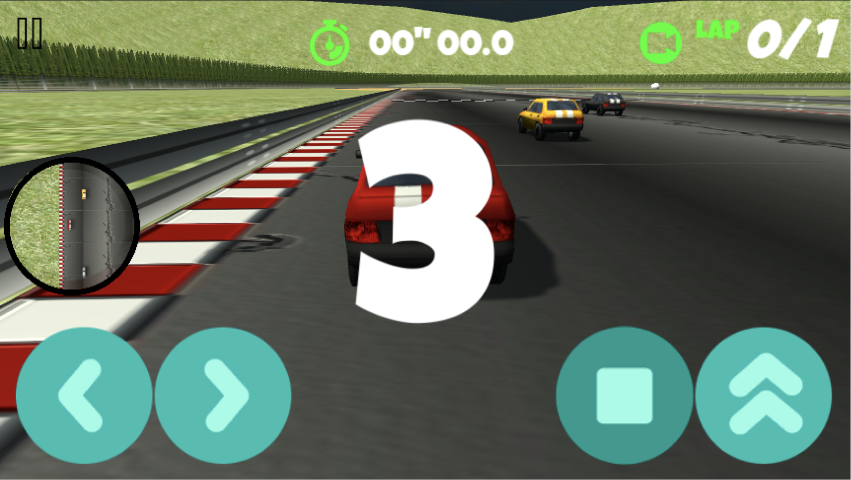
Start
Car Race
Technical Problems
-Operational crisis
-Monotonous gameplay
-Interaction fracture

Slide 10
B

Slide 11
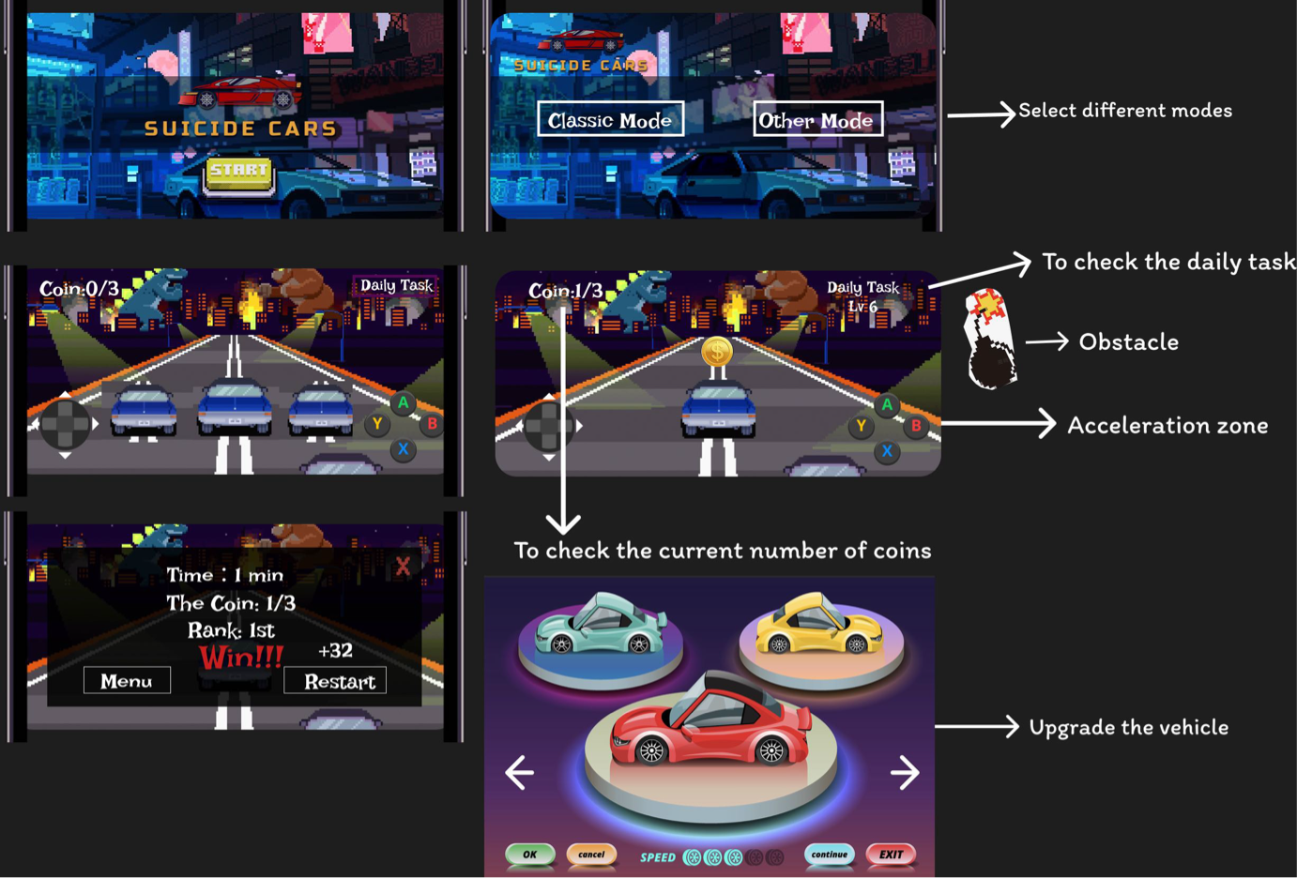

BENCH
App Mockup
Simply settings
Figma Design
Solution：
——Add function of driving backwards
——Award and risk mechanism
——The function of buttons

Slide 12
C

Slide 13

p
Drive Backward
Driving Backwards
Function

Slide 14
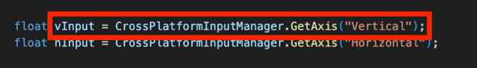
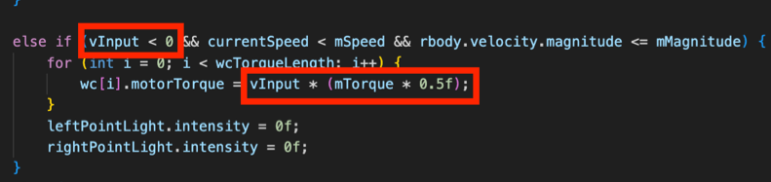
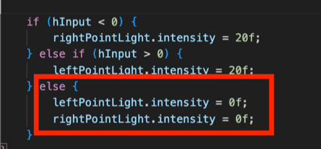
Drive Backward
Capture the input and perform the corresponding operation
realistic speed
-->play games in a more immersive way
turn signals
-->avoid interference

Slide 15
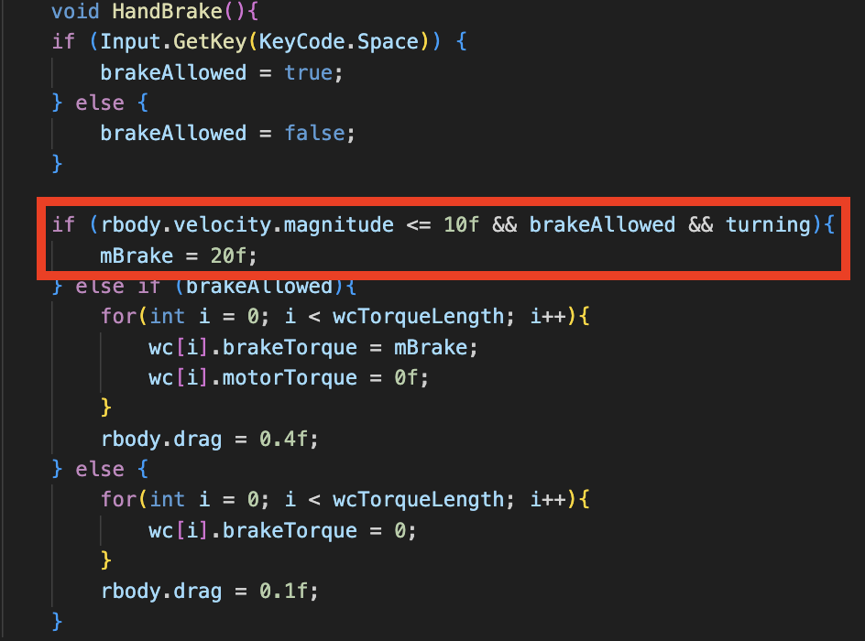
Drive Backward
-Activated a higher braking torque
-Better control its speed

Slide 16


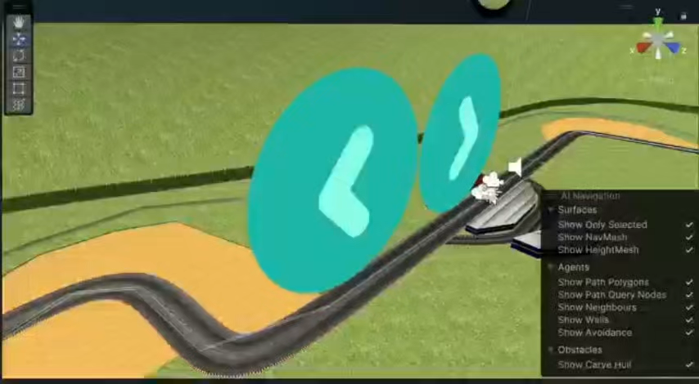
Phone Game
Point1
Point2
Point3
Point4
Operation Keys
Four Keys

Slide 17
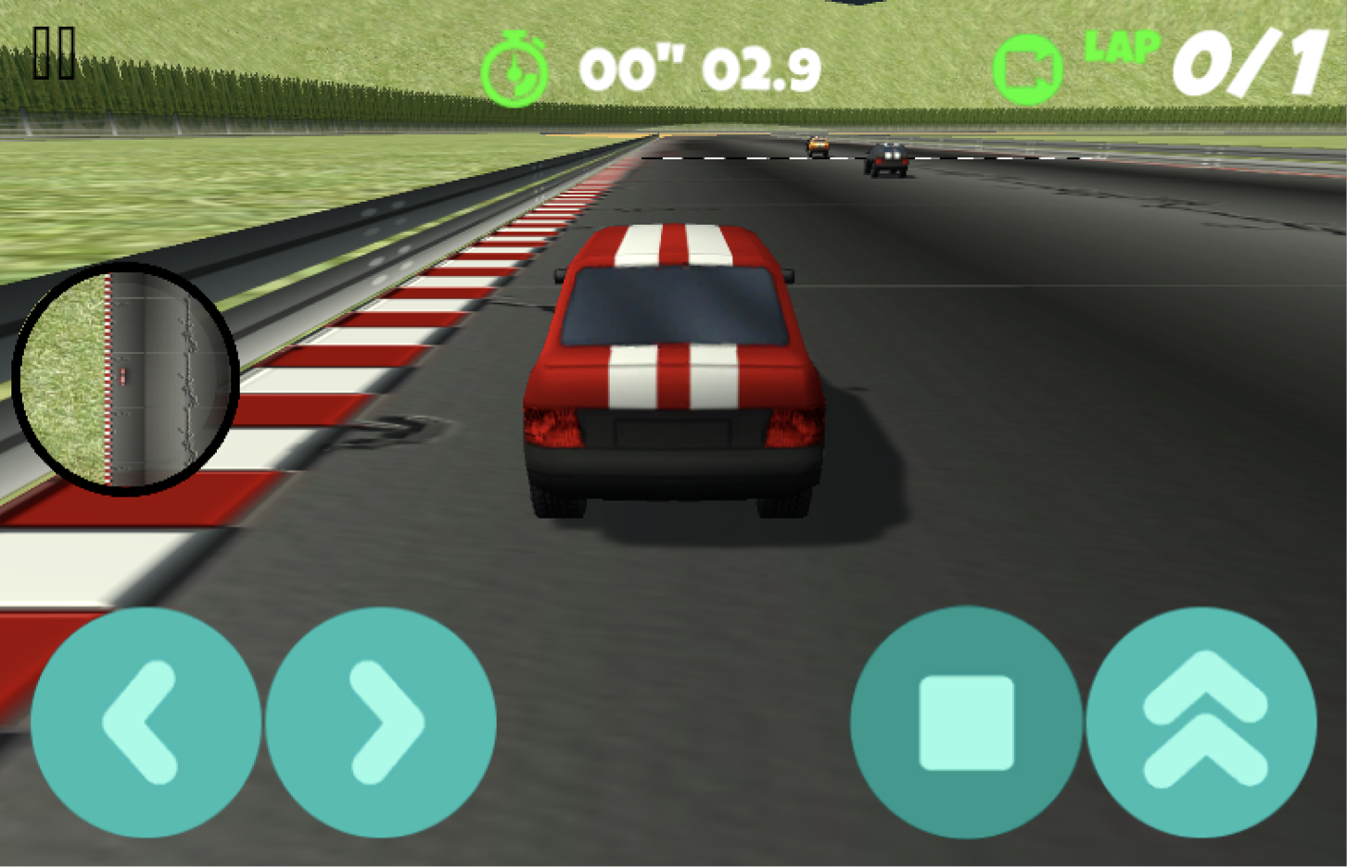
Keys
Purpose：HCI principles (clear goal)
get confused
Our problem: cannot play on phones
if play on phones(focus and immersion)
click listener purpose
releasing accelerate button purpose win &tring

Slide 18
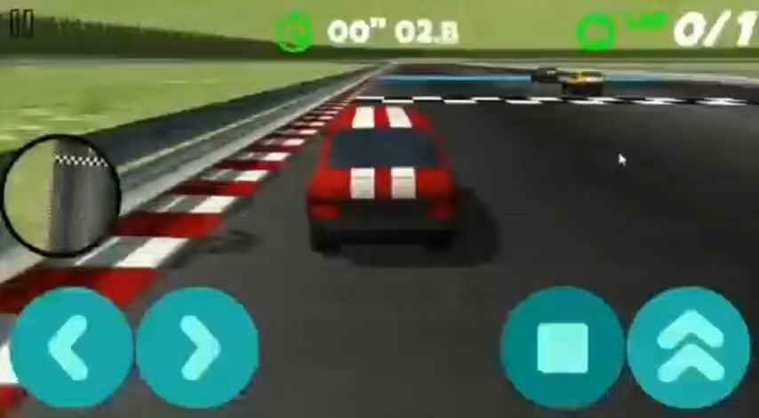
Faster！
Point1
Point2
Point3
Point4
Acceleration Belt
Speed up

Slide 19
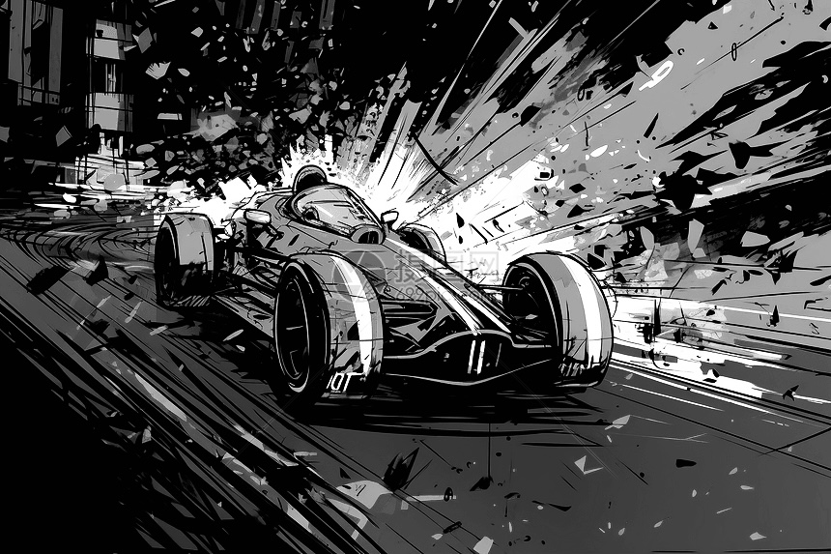
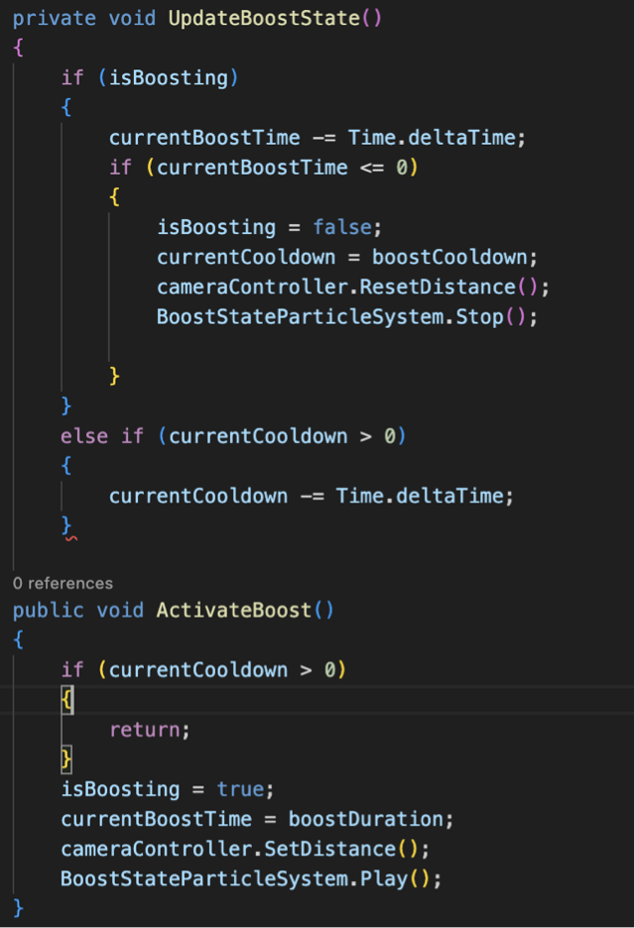
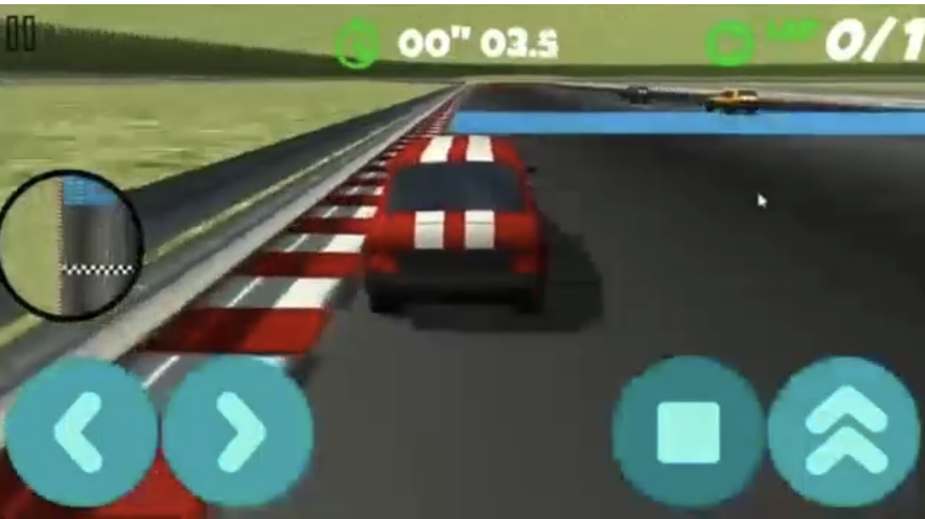
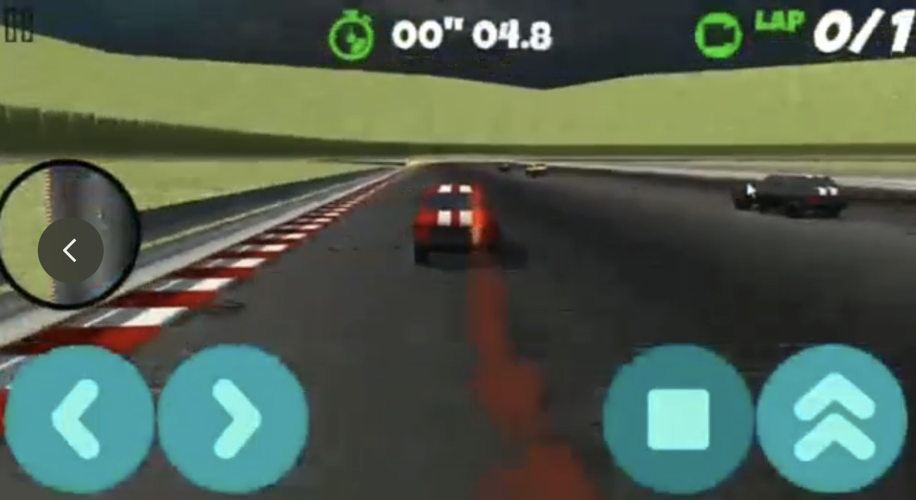
*boost__duration/effect/cameracontrol/particle effect
Acceleration Belt
Speed up
*detect player

Slide 20
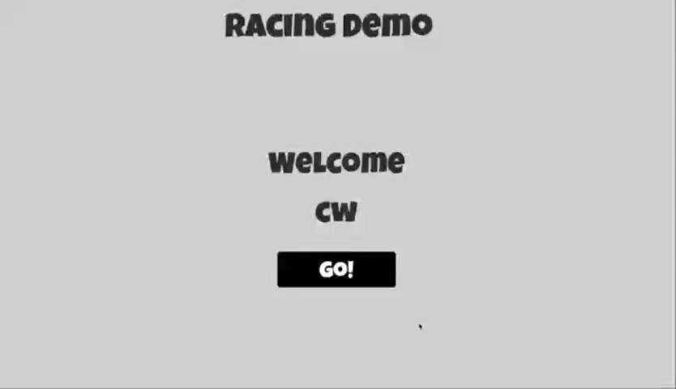
Final（After）
Changing Game
Changing Game

Slide 21
D

Slide 22

2026
automation
Future Expectations
Game mechanism changes:
-Players can choose different vehicle types (fossil fuel, electric, hybrid).
-The competition score is related to the "green driving index".
Improve Environmental Awereness
Environmental Protection Theme

Slide 23
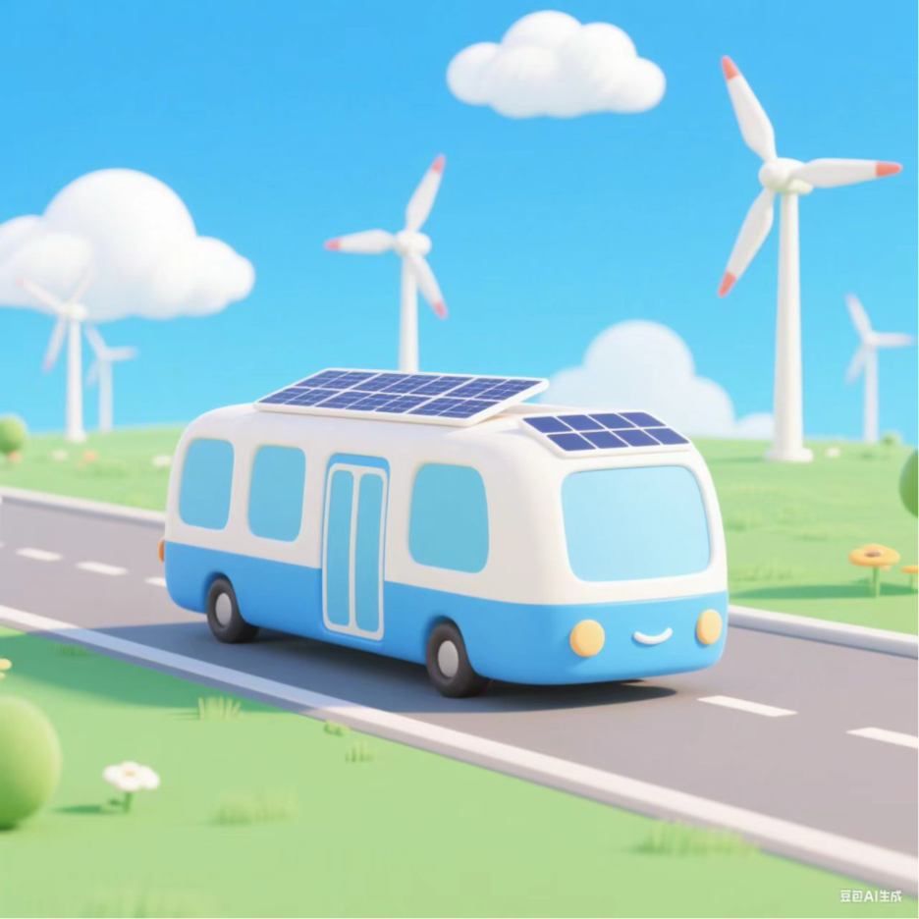
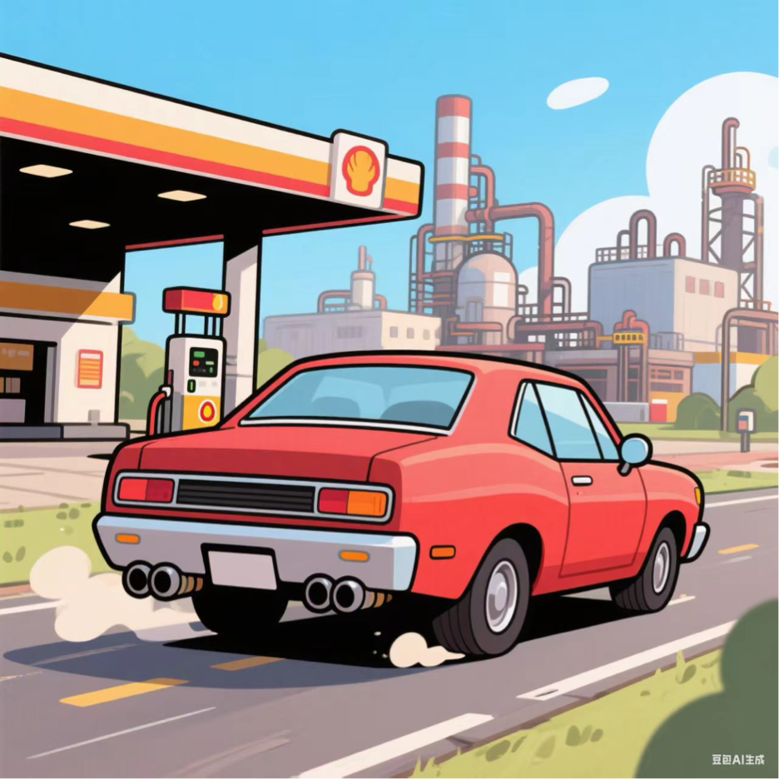
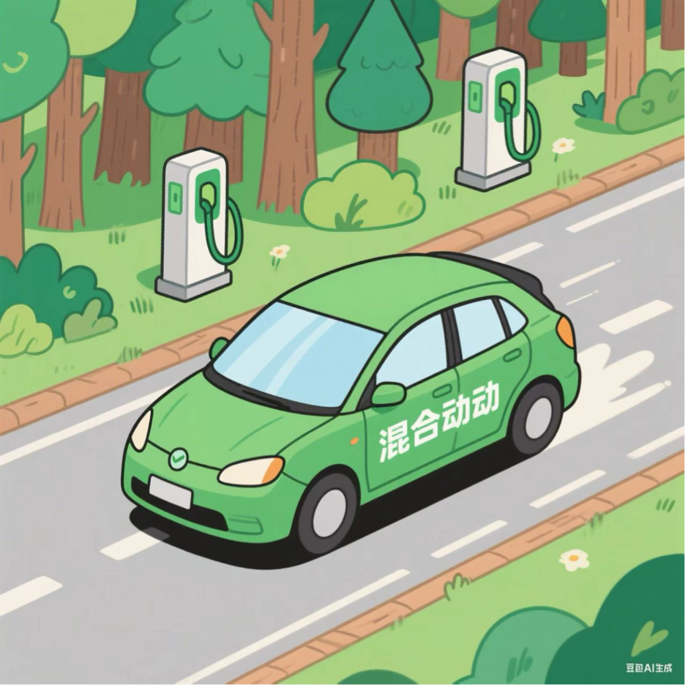
• Gas cars
• Electric cars
• Hybrid cars

Slide 24

Future Works
Persuasion Goals
Information Display
01
02
-Enhance players' awareness of carbon emissions and eco-friendly travel.
-After the game, it shows the impact of the player's driving on the environment and provides practical suggestions.

Slide 25




More On Game Design
-Add tracks of different difficulties
-Same weather as reality
-The AI opponent can adjust the speed of the vehicle
-Add a player store

Slide 26
RACE
Racing Game
THANKS
Made by Cassie Alice Angela Sylvia

